Slide 1









PITCH DECK
DECEMBER 2021
www.eatnoto.com

Slide 2
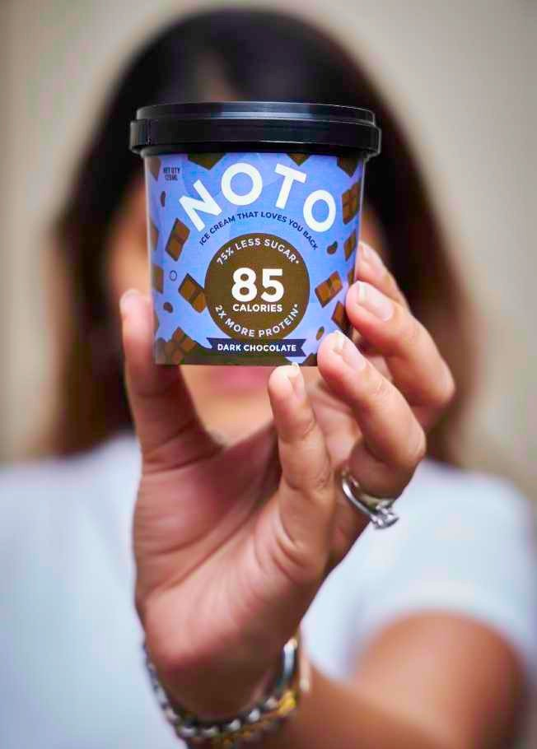























































TRANSACTION
OVERVIEW
ASK
INR 20 mn
PURPOSE OF FUND RAISE
Product Extension Marketing
TARGET
INR 120 mn ARR
MARQUEE INVESTORS ON BOARD
Raised INR 55 mn till date from marquee investors like Actor-Producer John Abraham, WEH Ventures, Titan Capital, Rockstud Capital & angels

Slide 3
PRODUCT MARKET FIT
MONTHLY REVENUE
INR 7 mn
PRESENT IN
Mumbai, Bangalore, Delhi
WEBSITE CUSTOMERS
12000
unique website customers
SOCIAL
CAPITAL
MEDIA
24k+
followers
EFFICIENCY
Used
INR 4.5mn
to reach
INR 85 mn
ARR

Slide 4
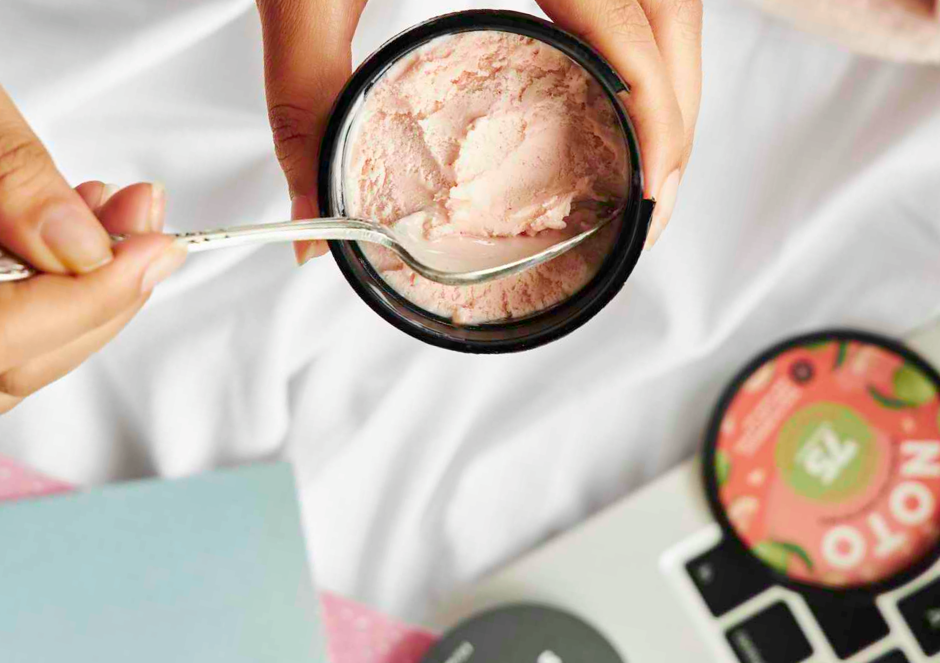
WHO ARE WE?
COMPANY
Founded in 2019, KAVV
Foods is a disruptive D2C healthy dessert company
focused on addressing key gaps in guilt-freeindulgence withtheir brand NOTO
VISION
Be the leader in
healthy desserts pan-India allowing customers to make smarter lifestyle
choices
WHO ARE WE
A packaged food brand for
the health conscious millennial Indian with an incurable sweet tooth.
Alternative sweets with Vegan, Low Calorie, Gluten Free, High Protein & Keto Friendly Options.

Slide 5
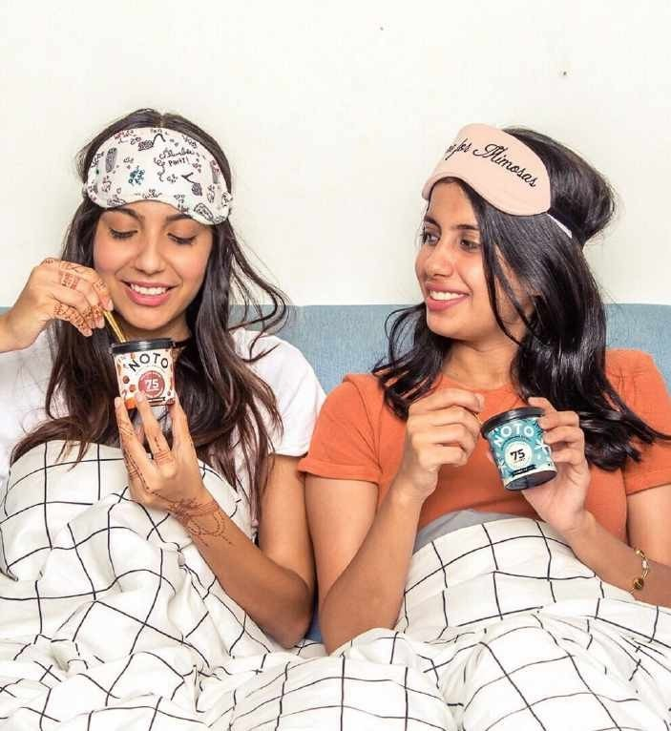
INDIA HAS A SWEET TOOTH!
MARKET SIZE
INR 200 bn
Ice Creams
INR 50 bn
Cakes
INR 125 bn
Chocolates
INR 200 bn
Confectionery*
Source – Expert Market Research, Company Estimates; *Sugarconfectionery

Slide 6
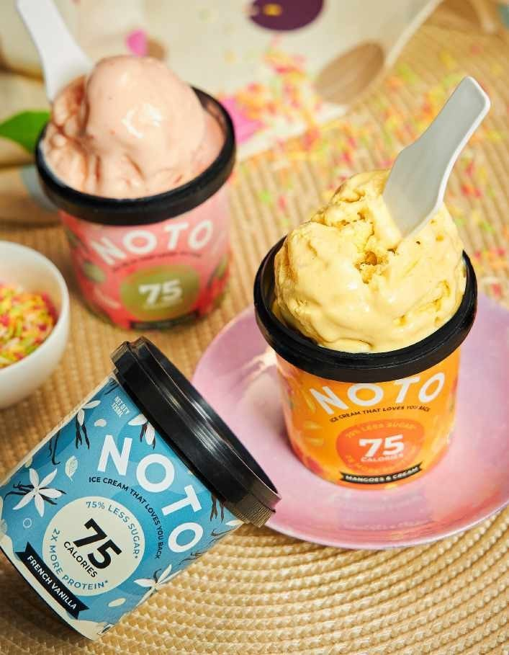
CONSUMER TRENDS
1
SHIFT TO HEALTHIER DESSERTS
Increasing wariness of the high fat & sugar content
TASTE IS KING
Unwillingness to compromise on taste and texture
QUALITY & TRANSPARENCY
Transparency in packaging, ingredients and labelling
2
3
FLEXIBILITY & CONVENIENCE
On-the-go packaging which encourages portion control
4
The High income household is expected to grow 3X over the next 10years, from 10Mn households to 30 Mn.
These consumers are moving towards ‘permissible indulgences’ and wish
to strike a balance between healthand desserts, especially after COVID-19

Slide 7
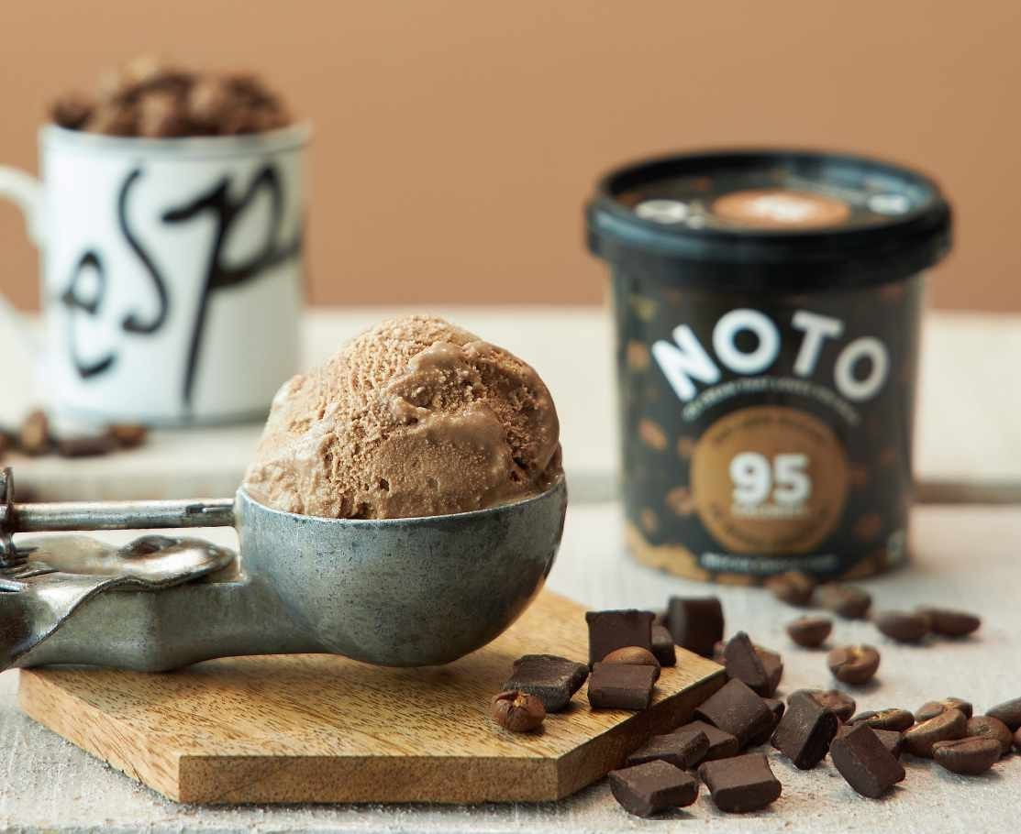
LOW CAL HIGH PROTEIN ICE CREAMS
LAUNCHED 2019

Slide 8
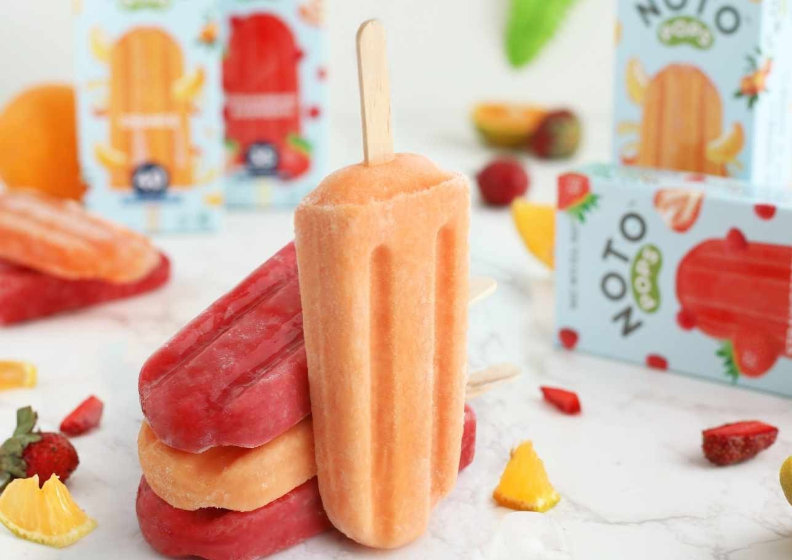
LOW CAL ZERO ADDED SUGAR REFRESHING POPSICLES
LAUNCHED 2020

Slide 9
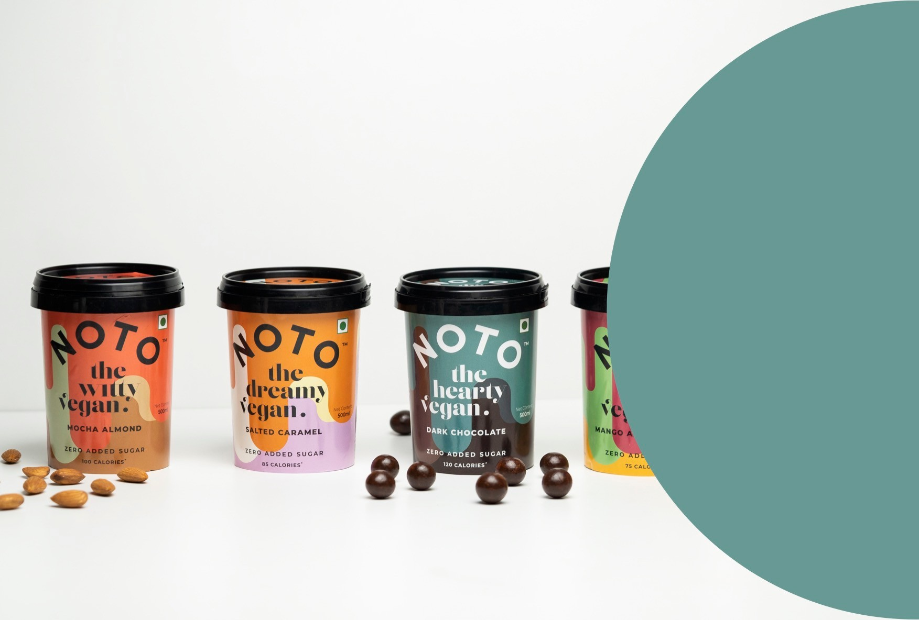
VEGAN ZERO ADDED SUGAR
ICE CREAMS
LAUNCHED 2021

Slide 10
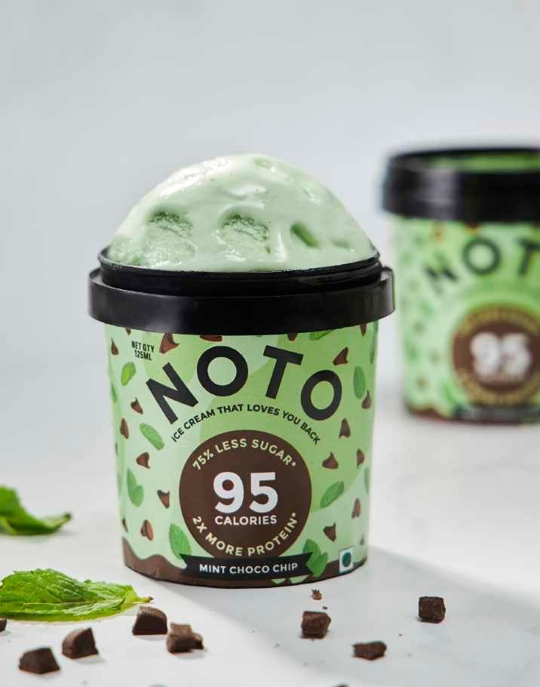
GROWTH
STRATEGY
Product expansion
Have a wide variety of healthy ice cream formats that cater to various dietary requirements.
Some of these examples would be:
Chocobar lite / magnum lite
Mini Bon Bons, Cones, Sandwiches
High Protein Kulfi
Vegan & Sugar Free Icecream
Greek Yoghurt Bars
Add new flavours to our existing ice cream & popsicle line.

Slide 11



GROWTH
STRATEGY
Channel expansion
Expand beyond D2C & Food Aggregators yet focus on Impulse channels.
With the ever growing popularity of online grocers coupled with the fact that NOTO’s range of products caters to impulse needs, we are looking to establish ourselves on Big Basket as well as Swiggy Instamart & Zepto.
We aim to service their 5k stores as opposed to their motherwarehouses for quick turn around time as well minimizing out of stock challenges.

Slide 12
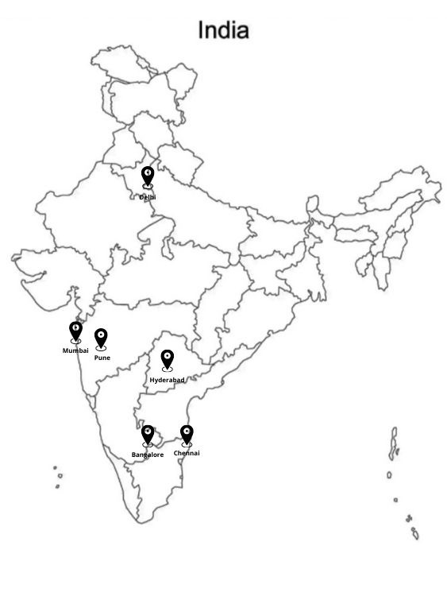
GROWTH
STRATEGY
Geographic expansion
Expand NOTO’s presence beyond Mumbai; Bangalore, Delhi, Chennai, Hyderabad & Pune.
As on Dec 15th we are live in the following 4 cities:
Mumbai
Bangalore (on ground team)
Delhi (on ground team)
On ground Ops team present
Pune
We plan to have 50 Swiggy Zomato PODs active by Summer of 2022 of which 40 are already live.

Slide 13
















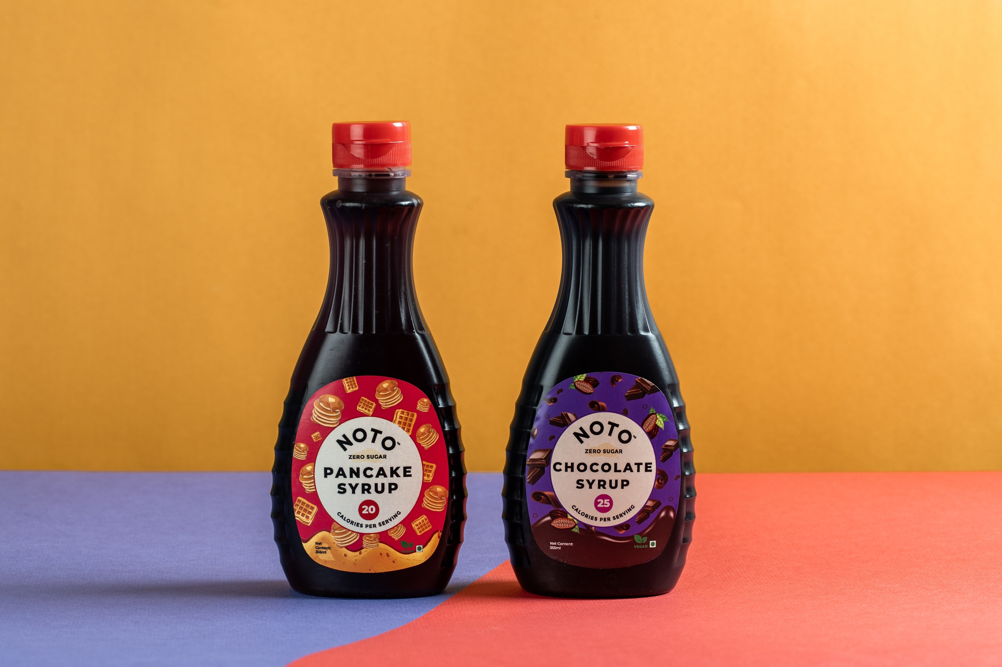



























GROWTH
STRATEGY
Ambient Products
Launch products with high frequency consumption and variety of applications,
addressing apparent market gaps, for our existing customers.
Products include:
Sugar Free Syrups like Hersheys Chocolate & American Garden Pancake
Indian Mithai
High protein pancake mix
Instant Oatmeal
The aim is to reach Pan India distribution through amazon and other market places.
LAUNCHING JANUARY 2022
Additionally we plan to leverage our PODs to maximise revenue of these new launches via food aggregators.

Slide 14
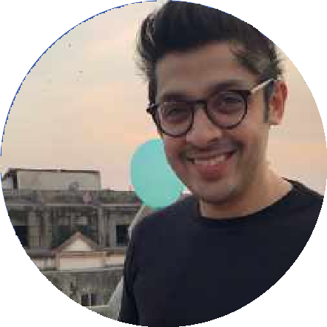
TEAM BEHIND NOTO
VARUN SHETH
CO-FOUNDER & CEO
A chef and serial entrepreneur, Varun Sheth has over a decade of experience in the hospitality industry
A graduate of The Natural Gourmet Institute NY, Varun has previously apprenticed at Lupa by Mario Batali in New York; He started his career with a gourmet catering company which then blossomed into 1Tablespoon (2012) that pioneered the concept of pizza-by-the-slice and 100% sourdough pizzas in Mumbai
He is now focused on taking NOTO pan-India while also adding to his range of dessert alternatives that are healthy without compromising on taste

Slide 15
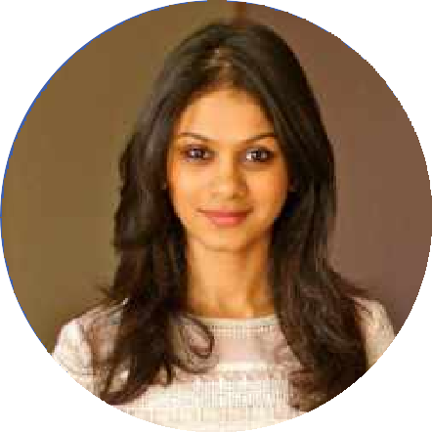
TEAM BEHIND NOTO
ASHNI SHAH
CO-FOUNDER & CMO
A design and fashion enthusiast, Ashni graduated from Istituto Marangoni in Milan. She then pursued a creative entrepreneurship course at ISDI Parsons in Mumbai
She previously worked at a garment export house, following which she launched her own clothing and jewelry brand
She took over the marketing and operations of Pizza kitchen by 1Tablespoon when the brand expanded to 3 outlets. Ever since there’s been no turning back from the hospitality line

Slide 16
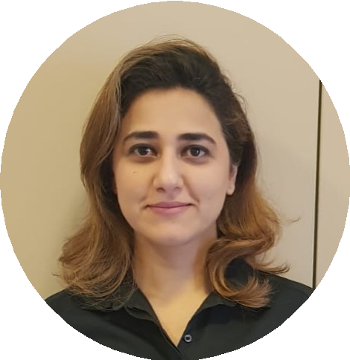
TEAM BEHIND NOTO
SAMONEH ETTEHAD
COO
In her experience of 15 years, Samoneh has donned various hats across industries and countries.
Iranian by descent, she started her career in India, working in leading investment banks such as Credit Suisse, JP Morgan and Deutsche Bank specializing in change and project management, business analysis and financial reporting.
She moved to Oman in 2017, where she forayed into F&B, conceptualizing and executing multiple businesses, generating 9-figure revenues.
She is an executive degree holder from IIM Calcutta and a certified scrum master, now pursuing her passion in scaling NOTO to the new heights.

Slide 17
THANK YOU

